Slide 1
TCP on Tokamak Programmes (CTP TCP)
Shunsuke IDE
Cadarache, France, 5-6 February 2025, IEA FUSION POWER CO-ORDINATING COMMITTEE (FPCC)

Slide 2
Outline
Membership
Meetings
Participation of the private sector
CICLOP: A Joint Task of the Co-operation between CTP and SH
Highlights

Slide 3










Membership
CTP TCP has 10 Contracting Parties (CPs) 6 IEA member countries:
Australian Nuclear Science and Technology Organisation (ANSTO), Australia
National Institutes for Quantum and Radiological Science and Technology (QST), Japan
Korean Ministry of Education, Science and Technology (MEST), Korea
United States Department of Energy (USDOE), United States
Ecole polytechnique fédérale de Lausanne (EPFL), Switzerland
Government of the United Kingdom, United Kingdom
1 partner country:
The Institute for Plasma Research (IPR), India
3 International Organizations:
European Atomic Energy Community (Euratom), European Union
ITER China Domestic Agency (CNDA)
ITER Organization

Slide 4
Membership
Switzerland joined the CTP TCP officially as a Contracting Party on 18th October 2022 and the nominated representatives from Switzerland are Ambrogio Fasoli and Paolo Ricci.
The UK joined the CTP TCP officially as a Contracting Party on 22nd January 2024 and the nominated representatives from the UK are Fulvio Militello and Fernanda Rimini.

Slide 5
Meetings
15th Executive Committee Meeting at the ITER Organisation Headquarters, St. Paul-lez-Durance, France, Friday 6th December 2024
27th meeting of the International Tokamak Physics Activity Coordinating Committee (ITPA CC) and 15th ITPA meeting for Joint Experiments at the ITER Organisation Headquarters, St. Paul-lez-Durance, France, 4th-6th December 2024

Slide 6
Participation of the private sector
The proposal and process for the use of the IEA CTP TCP Full Sponsor or Limited Sponsor scheme as a legal framework for the participation of privately funded companies in the ITPA activities has been approved through a written procedure ending on 15th January 2025.
It was also agreed that the proposal to invite Commonwealth fusion systems (US) to join ITPA in 2025 as an IEA CTP TCP Limited Sponsor should be approved through a written procedure launched on 15th January 2025 and ending 14th February 2025, following the approval by the ITPA Coordinating Committee at a meeting held via video conference on 16th January 2025.

Slide 7
Participation of the private sector
The Legal Office of IEA proposed recently to consider some amendments to the CTP’s Implementing Agreement (IA) to ensure that it aligns with CTP’s new strategy for engagement with privately funded entities including formalising CTP’s new strategy and reduce the risk of uncertainty going forward, to clarify the relative rights/obligations of limited sponsors within CTP TCP compared to other participants.
The Legal Office of IEA will advise on the types of changes that could be considered and explain the rationale of these amendments at a future ExCo meeting.

Slide 8
CICLOP: A Joint Task of the Co-operation between CTP and SH
The proposal for the establishment of the CICLOP Joint Task between the Co-operation on Tokamak Programmes (CTP) and Stellarators and Heliotrons (SH) Technology Collaboration Programmes (TCPs) has been approved.
The IEA TCP CTP Executive Committee agreed to establish initially the CICLOP Joint Task including the parties that are members of both TCPs (CTP and SH), i.e. initially without the full participation of Korea with observer status and proposed to discuss in the meanwhile the options available to fully involve Korea as soon as possible.

Slide 9
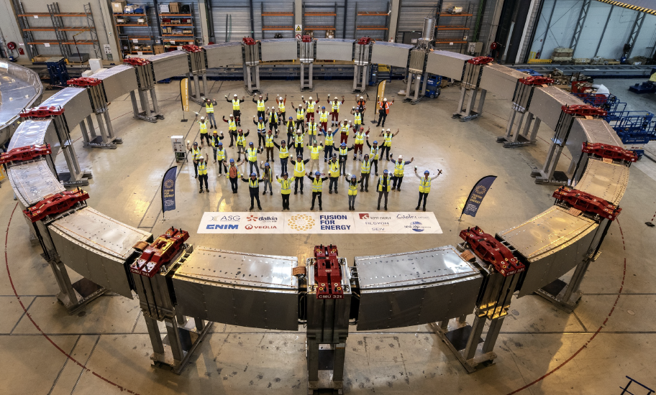
Highlights
Poloidal Field 3 Manufacturing Completed in May 2024
The ITER project has continued making steady progress towards first plasma with most plant support systems now in the commissioning phase. The construction of the toroidal field and poloidal field coils have now been completed.

Slide 10
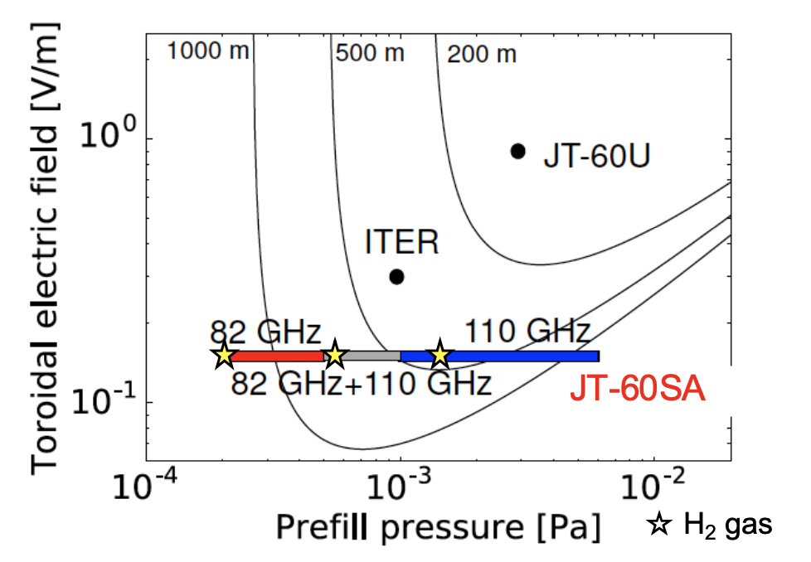
Highlights
In JT-60SA, a maintenance and enhancement phase started in 2024, for upgrading the heating systems, in-vessel components, diagnostics, reinforcement of the insulation of superconducting coils and interlocks, and modification of coil power supply aiming at high-power heating experiments.
Experiments in JT-60SA and subsequent data analysis confirmed stable plasma breakdown with a lower electric field than the one expected in ITER.
Plasma breakdown at low E||~0.12-0.15 V/m

Slide 11
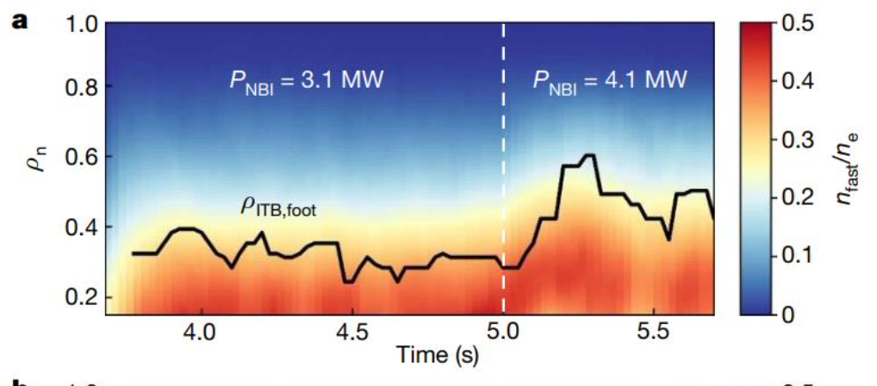

Highlights
The KSTAR high-performance long-pulse capabilities lead to the development of advanced scenarios in a fast ion regulated enhancement mode with an ion temperature of about 10 keV in the plasma core, sustained for up to 20 seconds.
The ratio of the fast-ion density to the electron density in the fast ion regulated enhancement mode in KSTAR

Slide 12

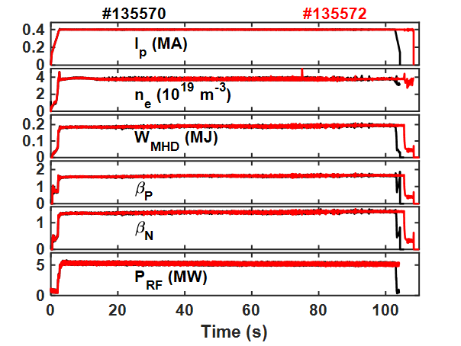
Highlights
Reproducible 100 seconds H mode with metal wall with Boron coating in EAST
The EAST operating window was extended with an ITER-like metal wall. A plasma scenario with a plasma ion temperature of 9 KeV was developed.
A steady state H-mode with a Boron coated metal wall was achieved with a reproducible H-mode and with a duration of more than 100 seconds.

Slide 13
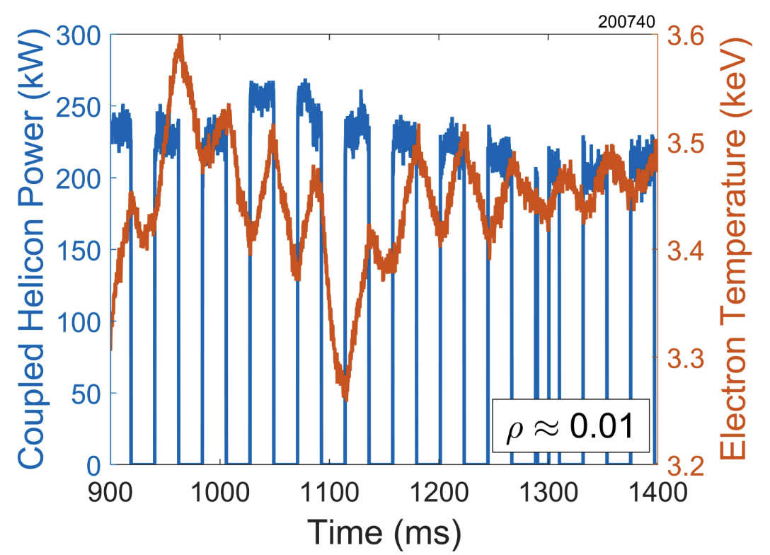
Highlights
Power coupled into DIII-D H-mode using the new helicon system
DIII-D completed a 16-week research campaign that included the commissioning of the shape / volume rise divertor and the operation of the new helicon system for up to 500 kW of power, yielding a central electron heating consistent with modelling.

Slide 14
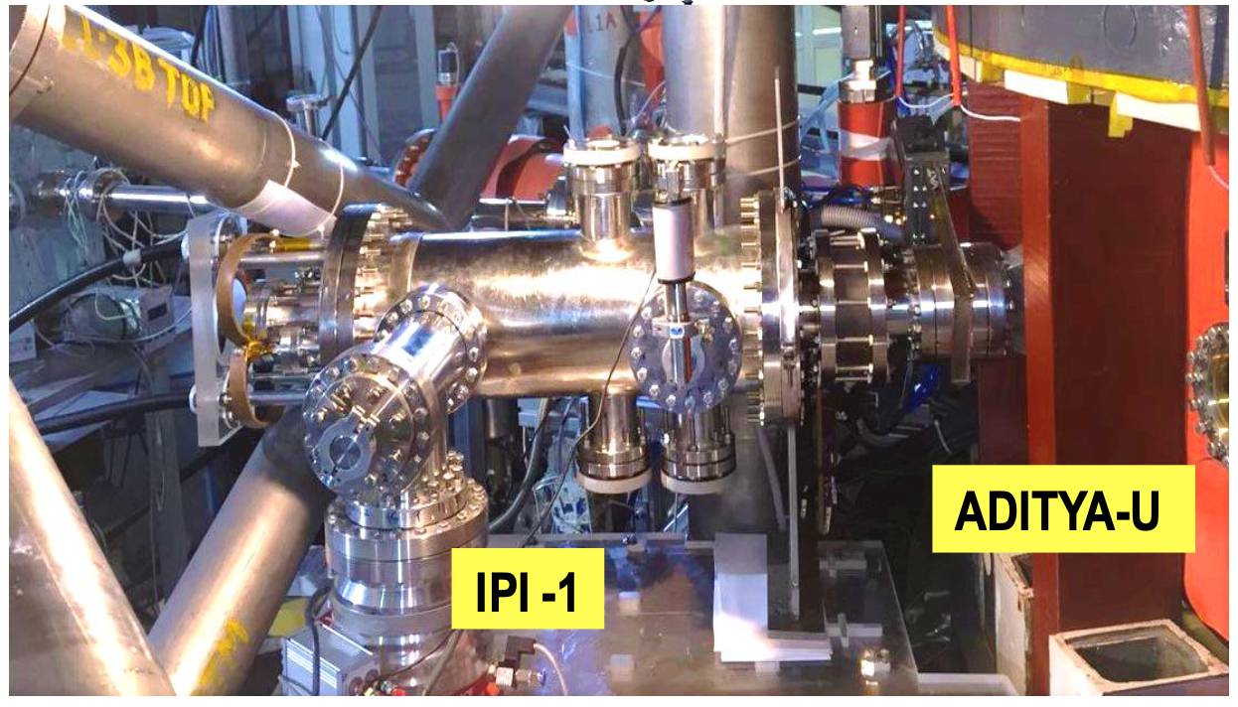
Highlights
Inductive Pellet Injector installed on ADITYA-U
An inductive pellet injector was installed in ADITYA-UG for delivering solid impurities deep inside the tokamak plasma. The cartridge can carry any material to be delivered in powdered form, and so far up to 250 mg of material was injected.

Slide 15
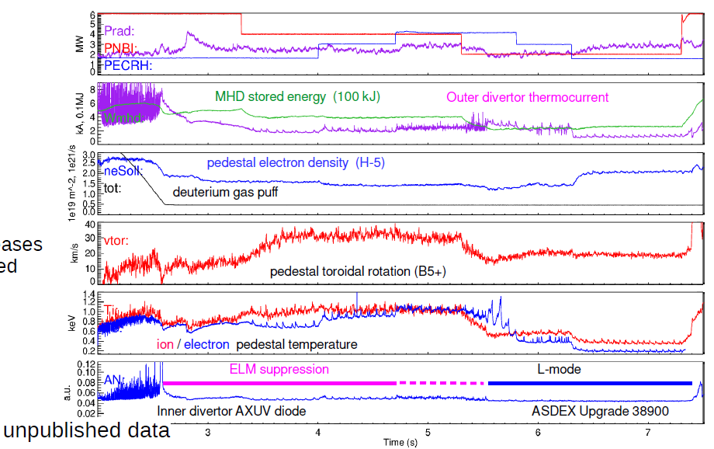
Highlights
Strong electron heating fraction can lead to loss of ELM suppression
In AUG, it was shown that strong electron heating can lead to loss of edge localised mode suppression likely due to the electron temperature approaching the ion temperature in the pedestal and not due to the reduction of the plasma rotation velocity.

Slide 16
Thank you for your attention

